Slide 1
Celebration of the word
for primary schools
Jubilee Year 2025:
Pilgrims of Hope

Slide 2
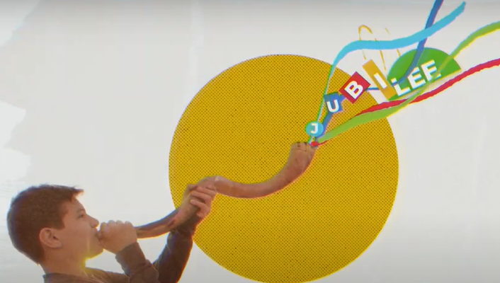
Gather
Hope does not disappoint, because God’s love has been poured into our hearts through the Holy Spirit that has been given to us” (Rom 5:1-2.5)

Slide 3
Gather

Slide 4
Gather

Slide 5
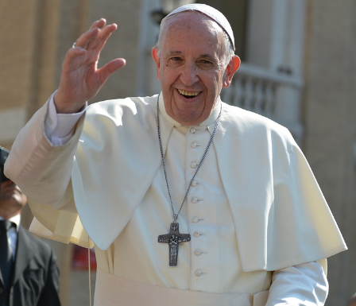
Gather…
“Let us celebrate with
deep faith
lively hope
active charity”

Slide 6
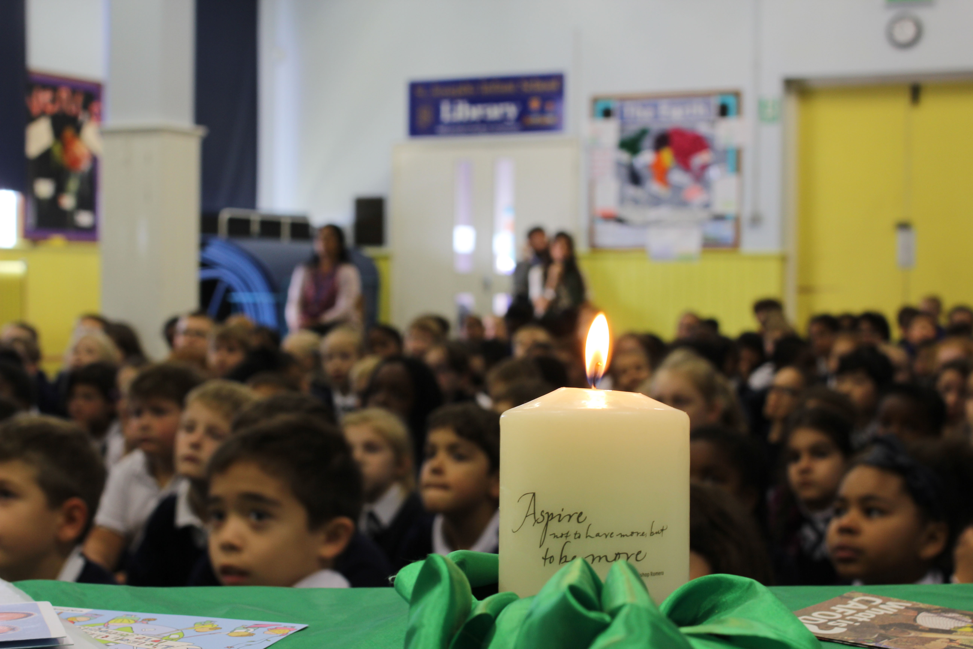
Word
A reading from the Gospel of Luke

Slide 7
Word
“The Spirit of the Lord is upon me, because he has chosen me to bring good news to the poor. He has sent me to proclaim liberty to the captives and recovery of sight to the blind, to set free the oppressed and announce that the time has come when the Lord will save his people.”

Slide 8
Respond
SACRED SILENCE…
Jesus tells us today what his mission on earth was:
to bring hope, peace and love to people’s hearts.
Can you remember how he did this?

Slide 9
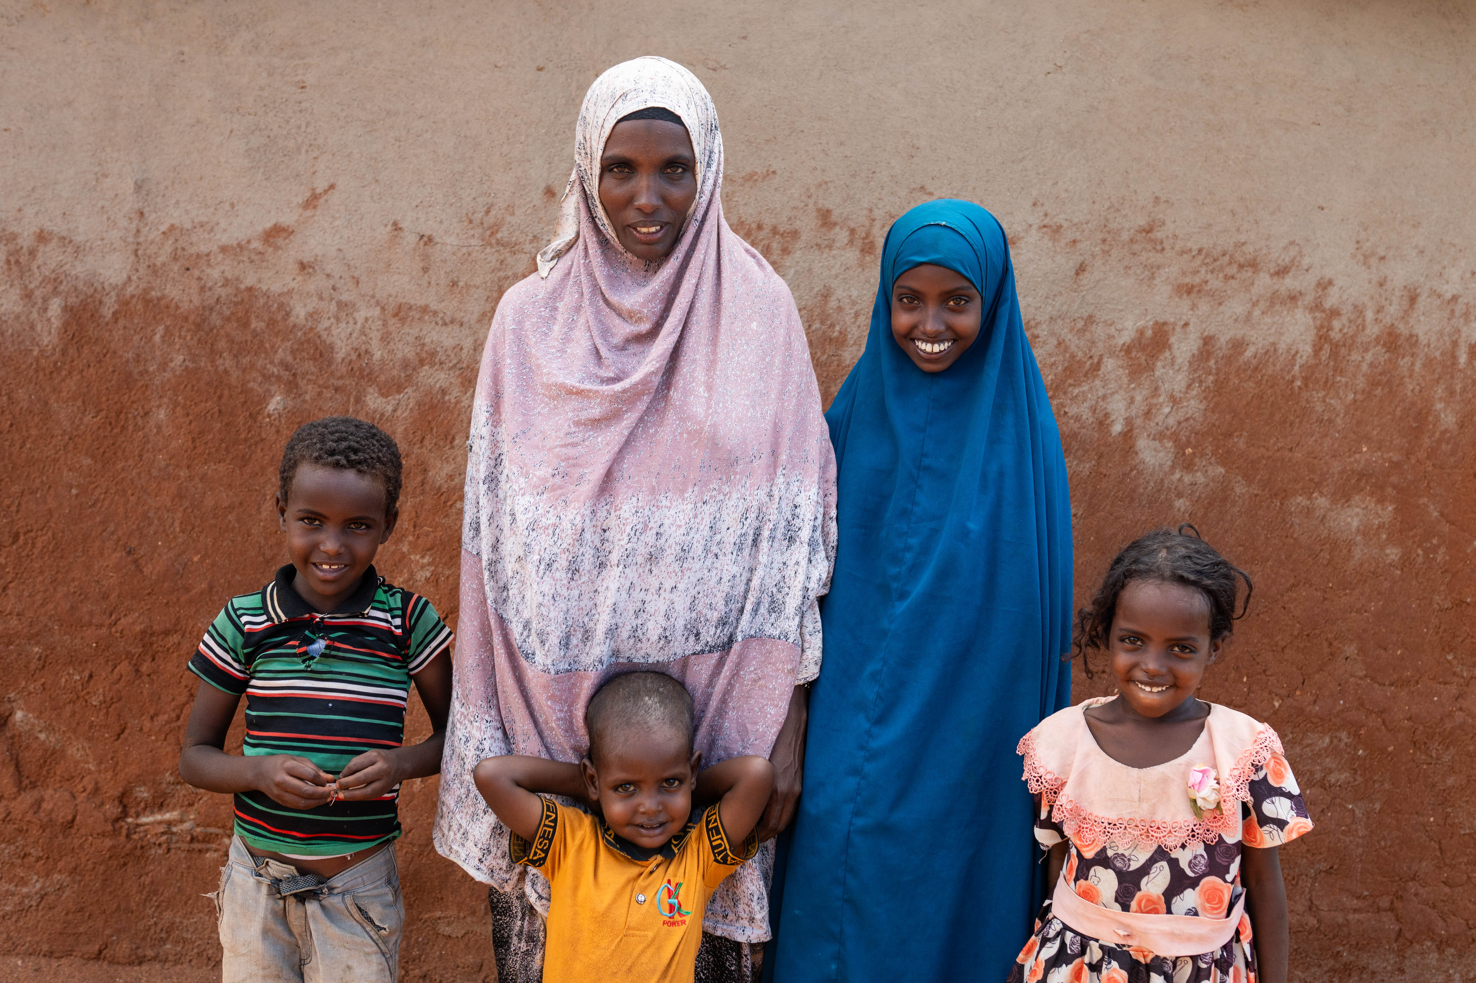

Slide 10
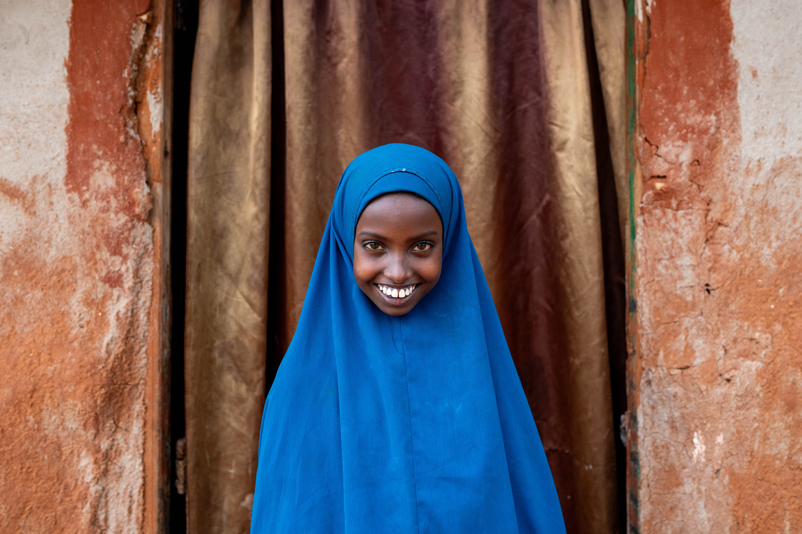
“There was no rain for years. Finding any water was very difficult.”
Chirri

Slide 11
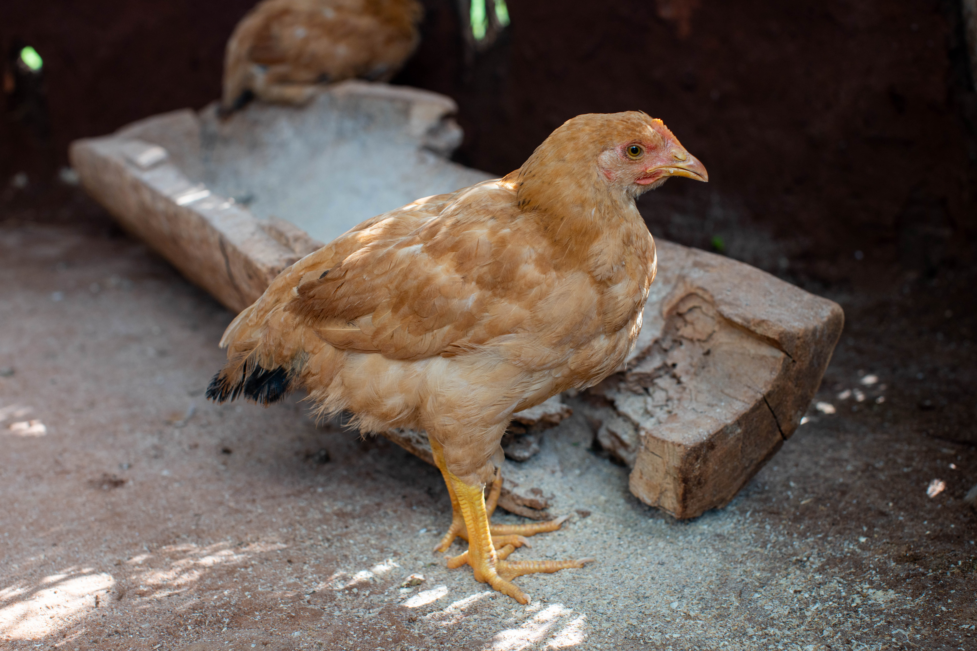

Slide 12
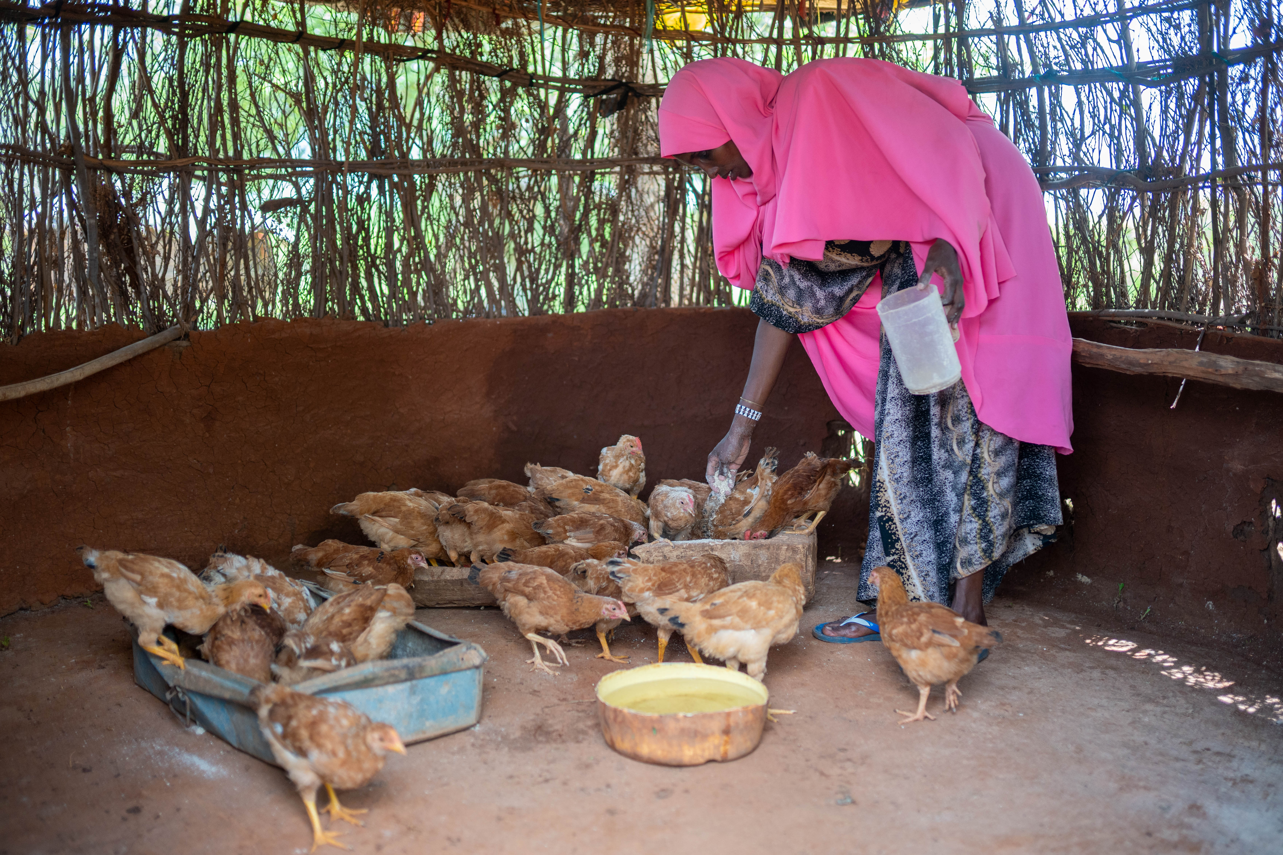

Slide 13
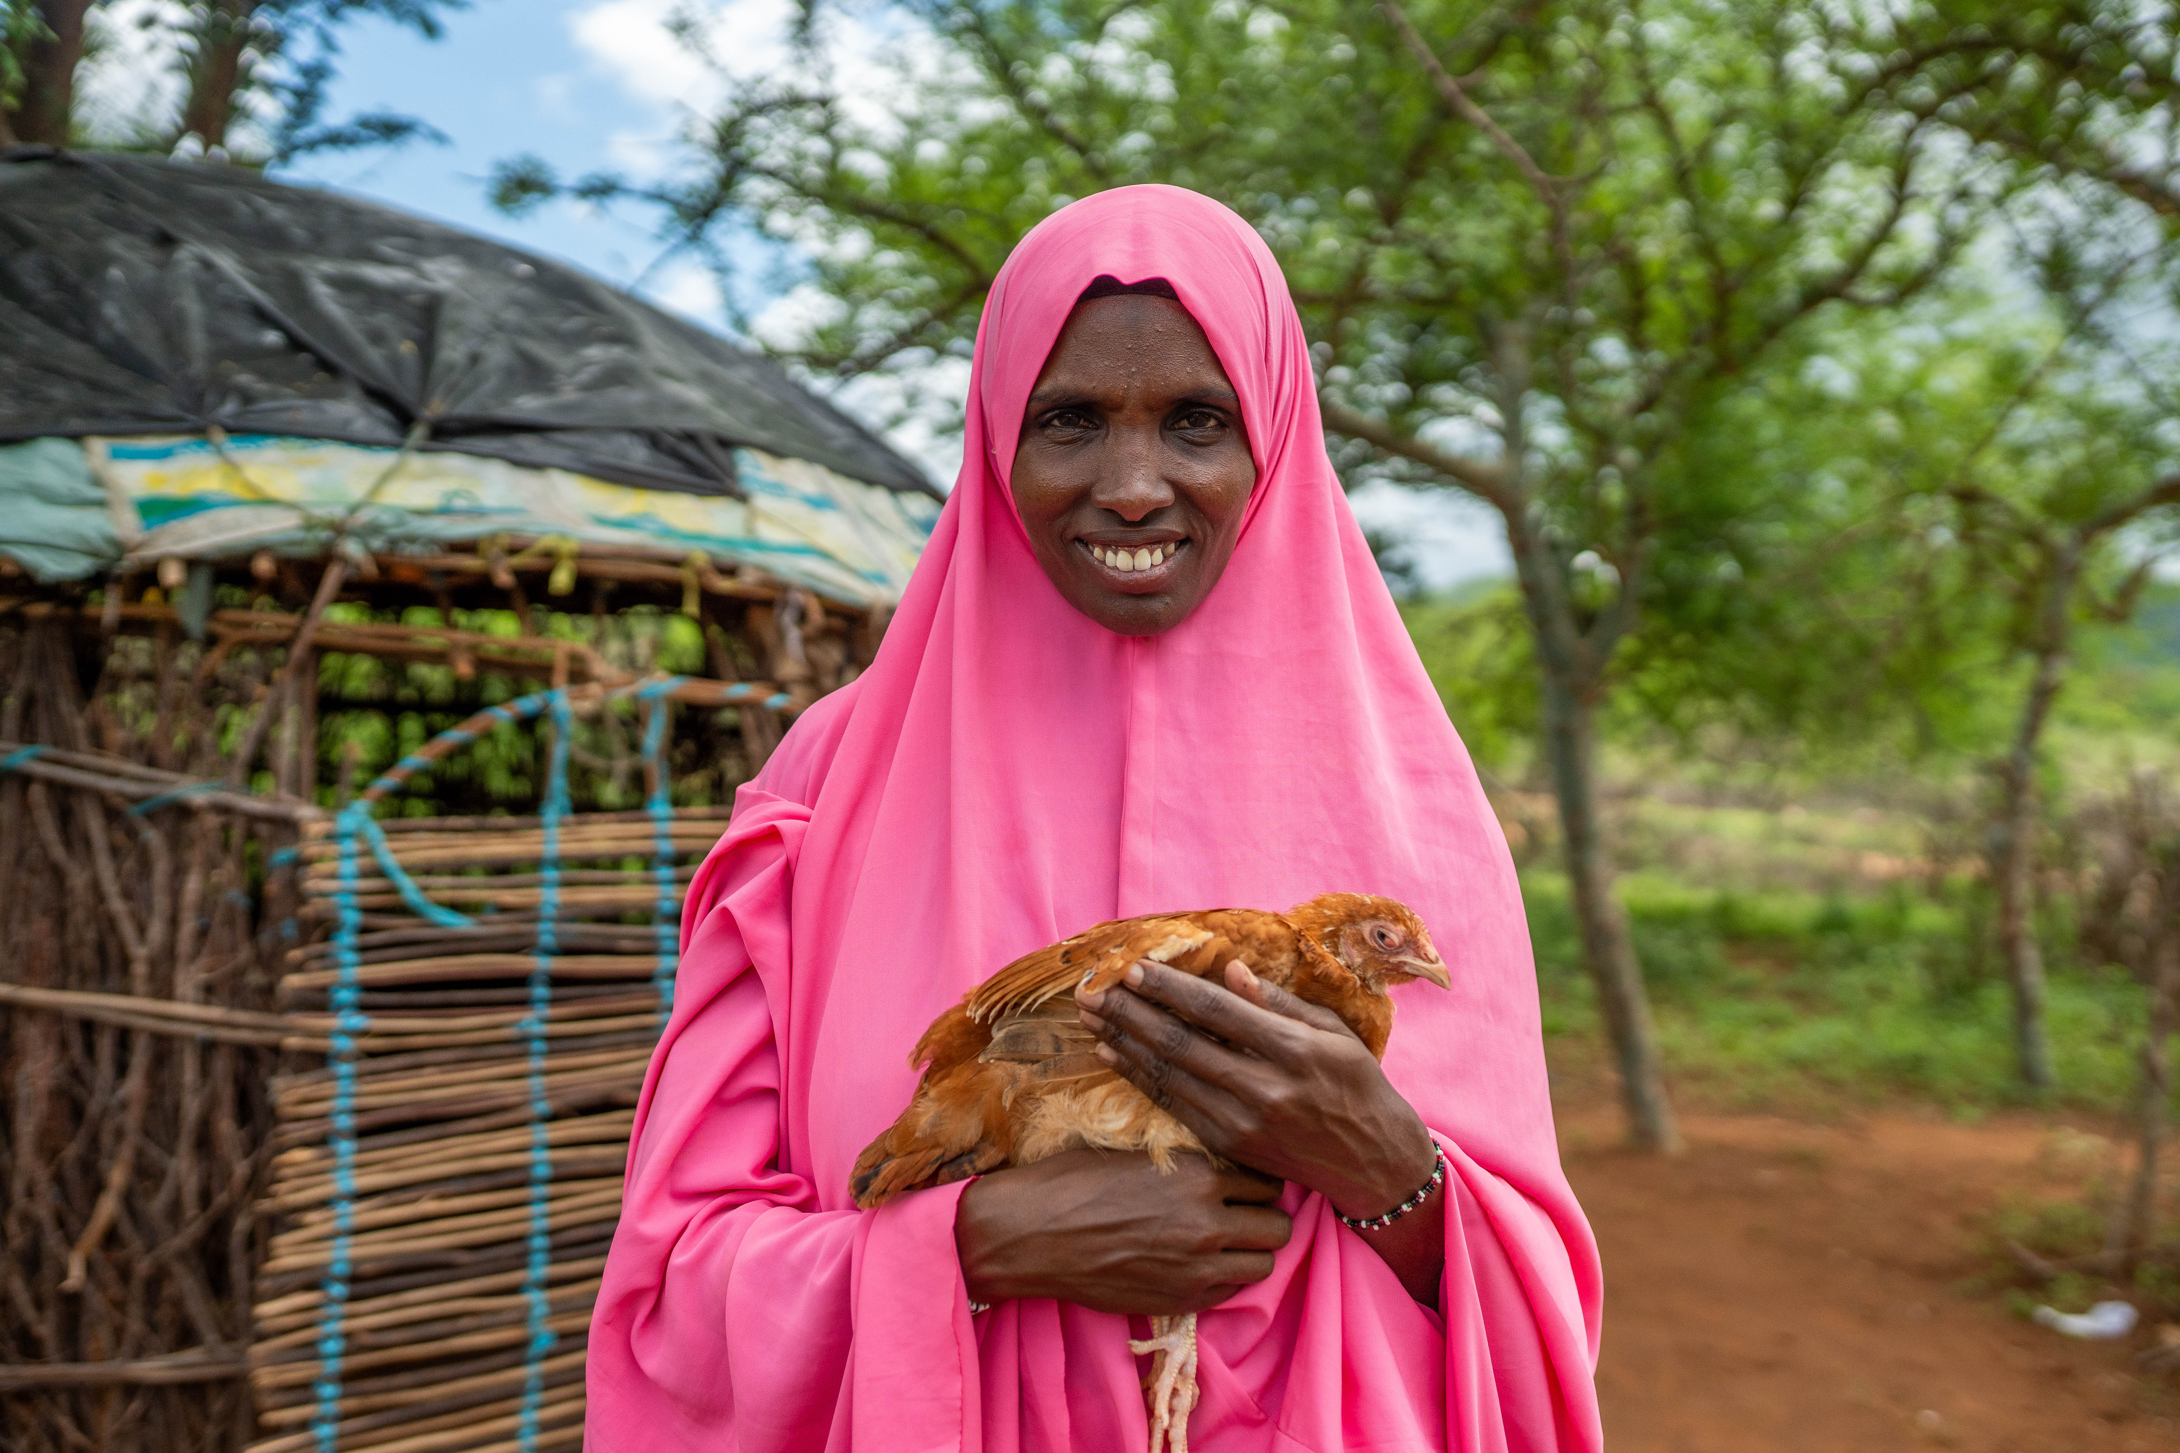
“Unity is strength. Let’s pull together to inspire. Let’s pull together to be strong.”

Slide 14
Send
What can we do to celebrate this
Jubilee Year with
deep faith,
lively hope
and active charity?

Slide 15
Send

Slide 16
Send
Let us pray:
God, our loving Father,
In this Jubilee year,
you remind us of our call to love creation.
Help us to work together to replant, repair and renew.
All: Guide us on our journey as pilgrims of hope. Amen.

Slide 17
Send
Let us pray:
Jesus, our light,
In this Jubilee year,
you remind us of our call to love our neighbours and to set free those who suffer.
Help us to treat everyone with dignity; to be fair, forgiving and kind.
All: Guide us on our journey as pilgrims of hope. Amen.

Slide 18
Send
Let us pray:
Holy Spirit, our inspiration,
In this Jubilee year, you remind us of our call to grow in faith and love. Help us to hear you in scripture, to see Jesus in others,
and to be united as God’s global family.
All: Guide us on our journey as pilgrims of hope. Amen.

Slide 19
Send
Let’s try hard to make this Jubilee Year 2025 a really special one where we can grow in hope, faith and love.

Slide 20
Send

